Slide 1
20277 מערכות בסיסי-נתונים‏ 4 נקודות זכות ברמה רגילה
Tuple relational calculus

Slide 2
6.2 The Tuple Relational Calculus תחשיב יחסים לפי שורות
nonprocedural query language.
{t | P(t)}

Slide 3
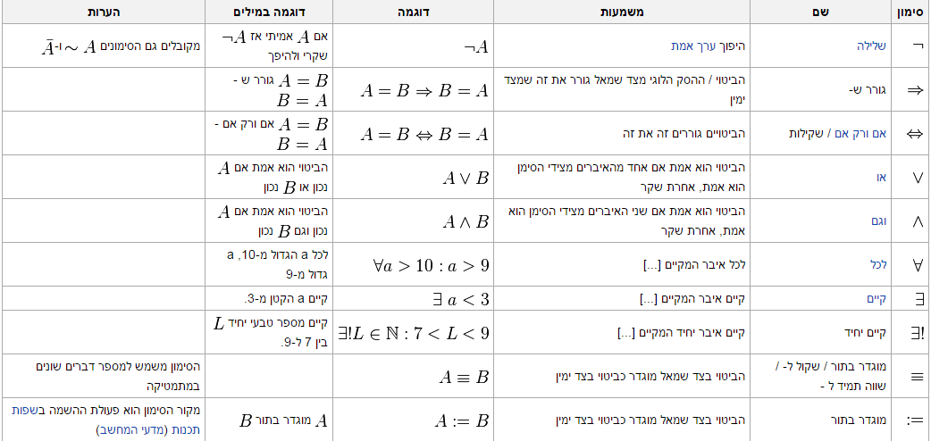
כדאי לשנן טוב טוב את הסימונים המתמטיים
https://he.wikipedia.org/wiki/%D7%A1%D7%99%D7%9E%D7%95%D7%9F_%D7%9E%D7%AA%D7%9E%D7%98%D7%99

Slide 4
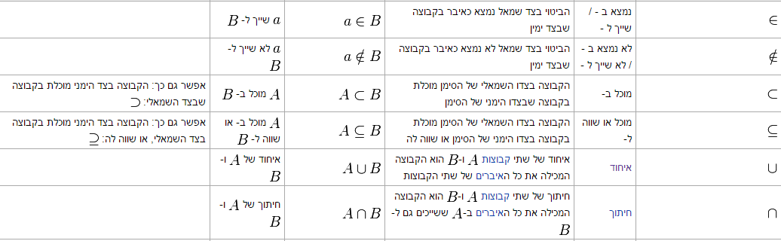
סימונים מתורת הקבוצות

Slide 5
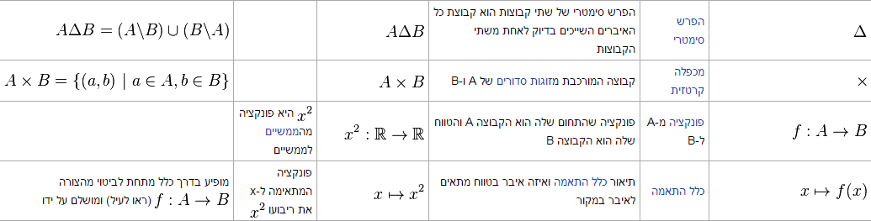
סימונים נוספים

Slide 6
{t | P(t)}
Set of all tuples t such that | Predicate P is true for P
we use t[A] to denote the value of tuple t on attribute A
יש שרושמים גם t.A ל value of tuple t
use t ∈ r to denote that tuple t is in relation r.

Slide 7
{t | t ∈ instructor ∧ t[salary] > 80000} איך קורים את זה בעברית ואנגלית
Find all fields for instructors whose salary is greater than $80,000
כתיבה זו מחזירה את כל השדות של הרשומה t כאשר ה salary > 80000
Set of all tuple t such that t in relation instructor and salary attribute > 80000

Slide 8
IDנניח שרוצים רק את ה
{t | ∃ s ∈ instructor (t[ID] = s[ID]∧ s[salary] > 80000)}
∃ means “there exists” קיים
| such that כך ש
The set of all tuples t such that there exists a tuple s in relation instructor for which the value of t and s for the attribute ID are equal and the value of s for the salary is greater then 80000

Slide 9
Working on two relations
“Find the names of all instructors whose department is in the Watson building.”
{t | ∃ s ∈ instructor (t[name] = s[name]
∧ ∃ u ∈ department (u[dept name] = s[dept name]
∧ u[building] = “Watson”))}
To find the set of all courses taught in the Fall 2009 semester, the Spring 2010 semester, or both:
In Sql:
select ID from section where semester = 'Fall' and year = 2009 union distinct
select ID from section where semester = 'Spring' and year = 2010
{t | ∃ s ∈ section (t[course id] = s[course id])
∧ s[semester ] = “Fall” ∧ s[year ] = 2009)}
∨ // Or operation , the union
∃ u ∈ section (u[course id] = t[course id])}
∧ u[semester ] = “Spring” ∧ u[year ] = 2010)}

Slide 10
Find all students who have taken all courses offered in the Biology department.
select * from takes where course_id = some (select course_id from course where dept_id='1')
We introduce the “for all” construct, denoted by ∀.
{t | ∃ r ∈ student (r[ID] = t[ID]) ∧
( ∀ u ∈ course (u[dept_name] = “ Biology” ⇒
∃ s ∈ takes (t[ID] = s[ID]
∧ s[course id] = u[course id]))}
הקושי בכתיבה היא איך קוראים את זה בכלל:
In English, we interpret this expression as “The set of all students (that is, (ID)
tuples t) such that, for all tuples u in the course relation, if the value of u on attribute
dept_name is ’Biology’, then there exists a tuple in the takes relation that includes
the student ID and the course id.”

